Slide 1
Unit III Further Steps in Deep Learning – part 1
Subject: Artificial Intelligence,
Final Year, BTech: Department Elective (Electronics, E&TC)

Slide 2
Contents of the Unit
Principle and need of Transfer Learning in Machine Learning and Deep Learning
Deep learning image classification topologies like LeNet, AlexNet
VGG-16/VGG-19
Inception and ResNet, GoogleNet
Introduction to Recurrent Neural nets (RNN).

Slide 3
This ppt …
What is Transfer Learning (TL) ?
Need, Principle
TL in CNN
Understanding Databases used in DL

Slide 4
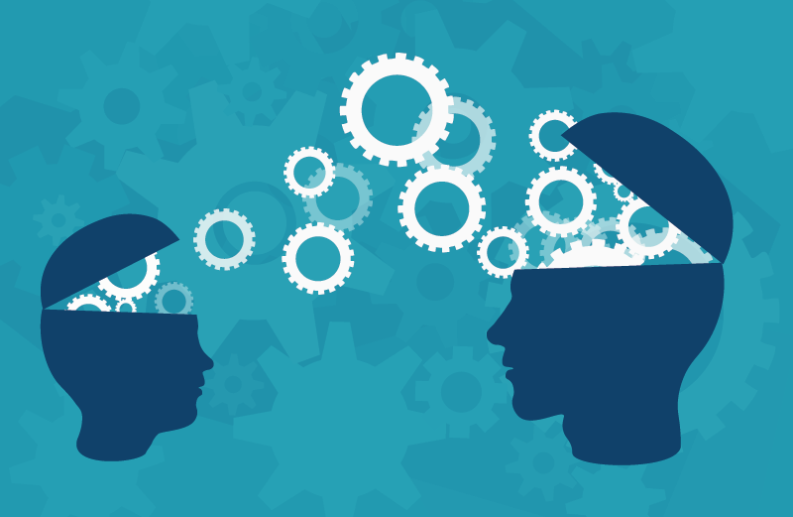
Motivation
The study of Transfer learning is motivated by the fact that people can intelligently apply knowledge learned previously to solve new problems faster or with better solutions.

Slide 5
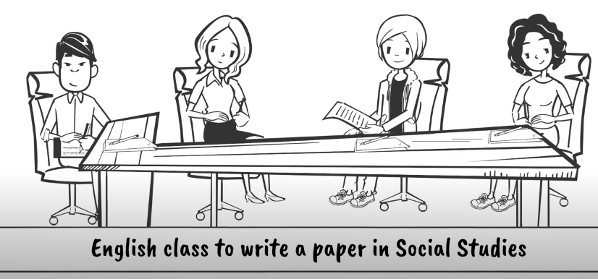
Transfer Learning

Slide 6
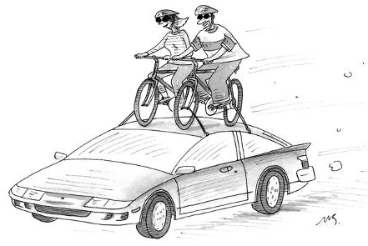
Revisiting Transfer Learning

Slide 7
Technically Speaking….
Transfer learning is the reuse of a pre-trained model on a new problem.
In transfer learning, the knowledge of an already trained machine learning model is applied to a different but related problem.
For example, if you trained a simple classifier to predict whether an image contains a backpack, you could use the knowledge that the model gained during its training to recognize other objects like sunglasses.

Slide 8
“What to transfer” in learning
Instance-transfer approach,
The feature-representation-transfer approach,
The parameter-transfer approach,
The relational-knowledge transfer approach

Slide 9
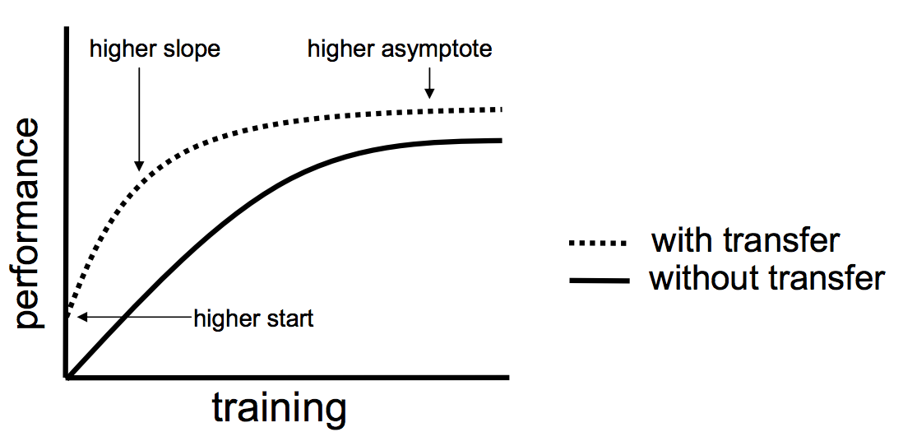
Advantages:
Saving training time
Better performance of neural networks (in most cases)
Not needing a lot of data.

Slide 10
Convolutional networks (ConvNets) have recently enjoyed a great success in large-scale image and video recognition (Krizhevsky et al., 2012; Zeiler & Fergus, 2013; Sermanet et al., 2014; Simonyan & Zisserman, 2014) which has become possible due to the large public image repositories, such as ImageNet (Deng et al., 2009), and high-performance computing systems, such as GPUs or large-scale distributed clusters (Dean et al., 2012).
In particular, an important role in the advance of deep visual recognition architectures has been played by the ImageNet Large-ScaleVisual Recognition Challenge (ILSVRC) (Russakovsky et al., 2014), which has served as a testbed for a few generations of large-scale image classification systems, from high-dimensional shallow feature encodings (Perronnin et al., 2010) (the winner of ILSVRC-2011) to deep ConvNets (Krizhevsky et al., 2012) (the winner of ILSVRC-2012).

Slide 11
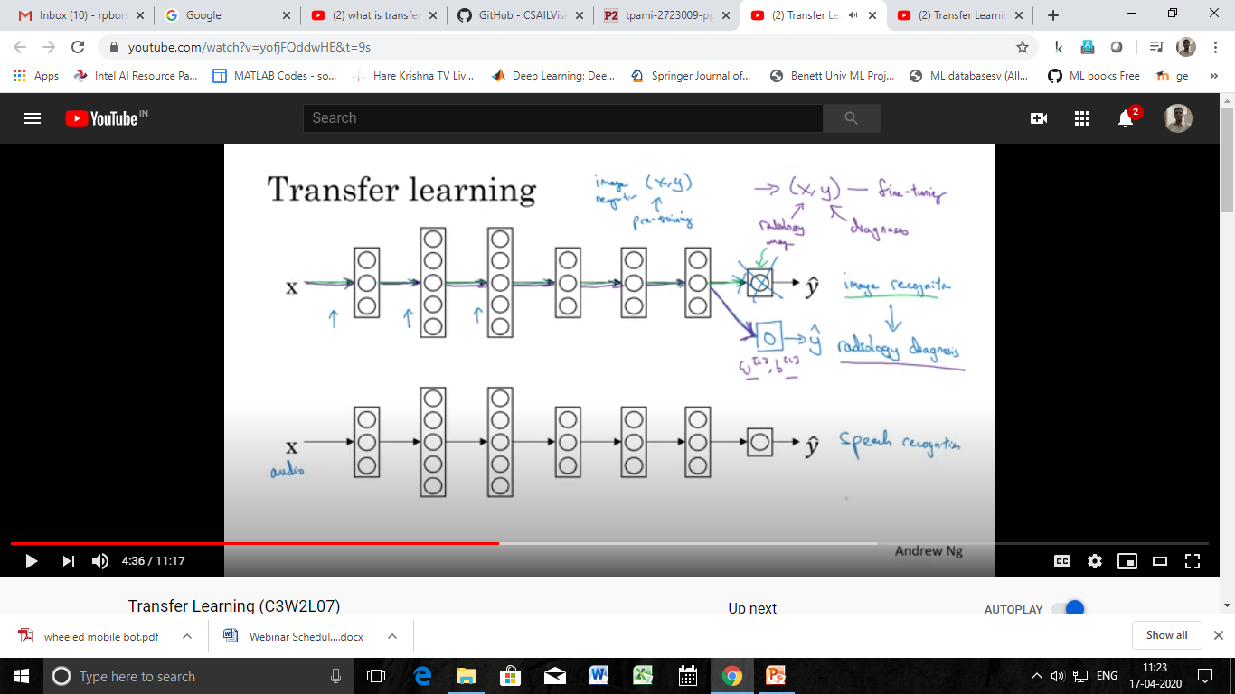
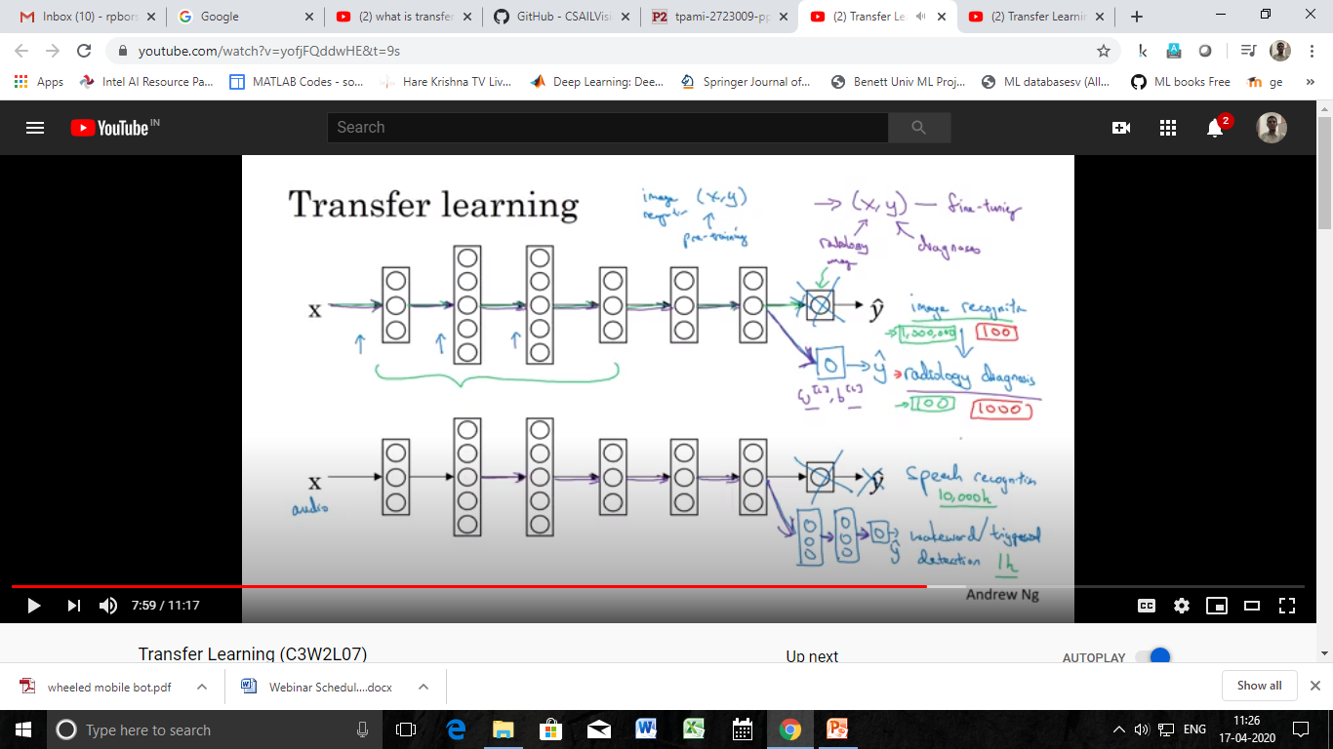
TL
Lets say we have a ANN for a speech recog application
If we apply TL for this…..

Slide 12
The popular CNN

Slide 14
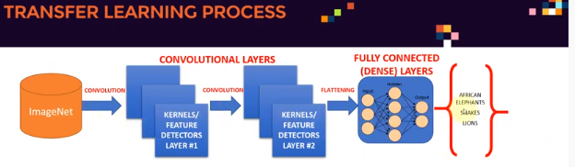
Another Example for TL - DL

Slide 15
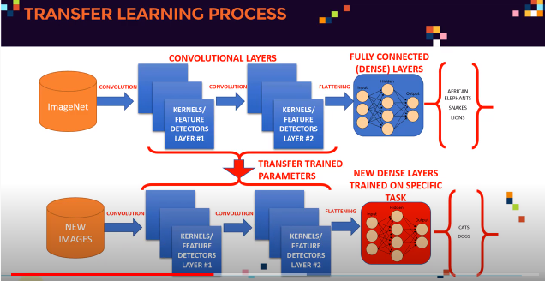

Slide 16
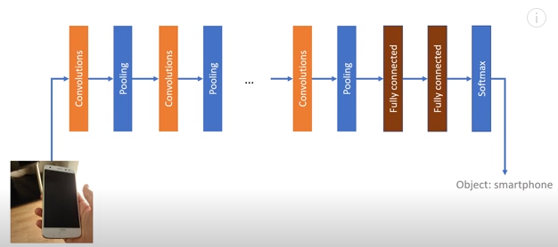
An example of TL in DL - CNN
https://www.youtube.com/watch?v=_2EHcpg52uU

Slide 17
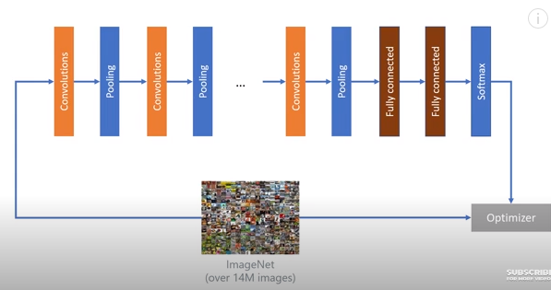
CNN trained on a big database

Slide 18
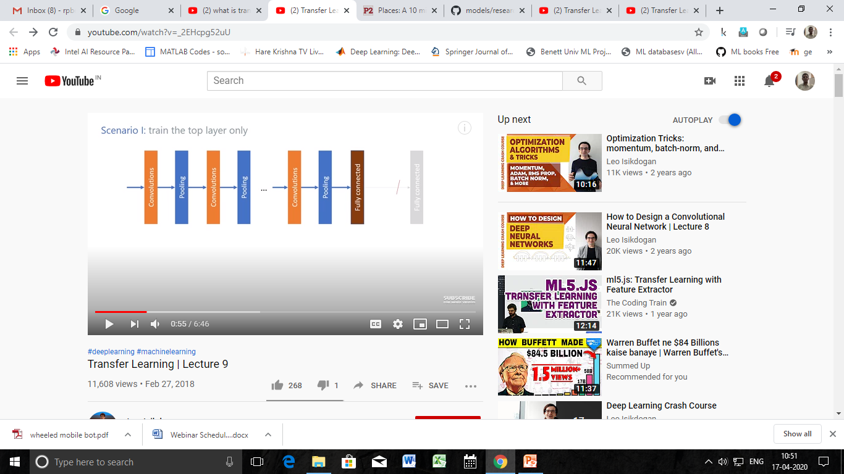
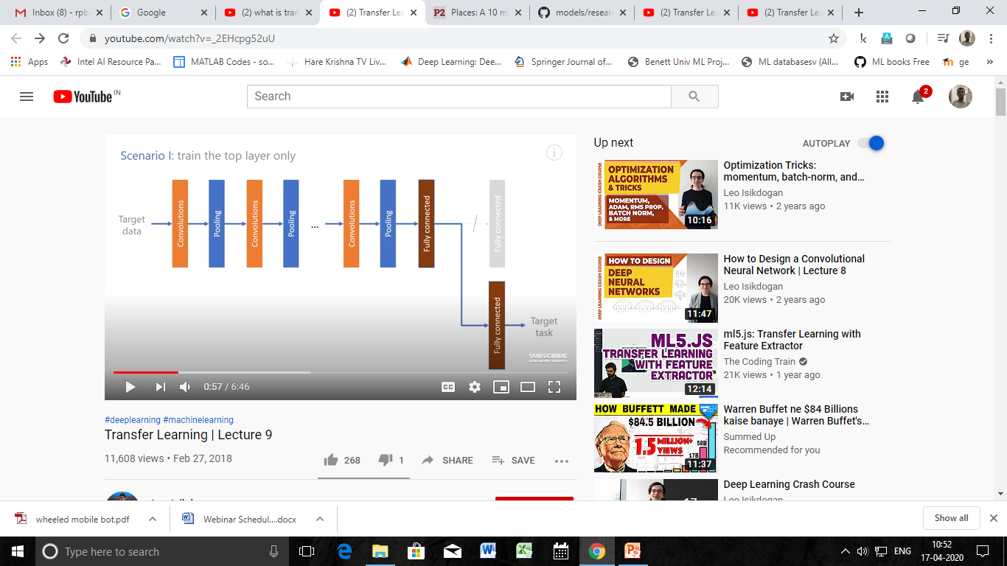
Technique 1: Train the Top layer model only

Slide 19

Technique 2: Fine tune all layers

Slide 20
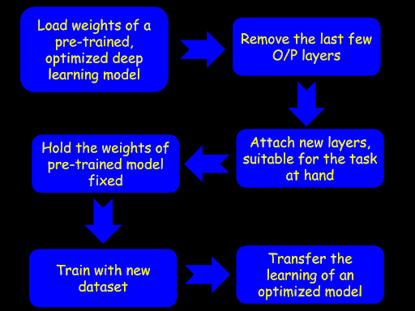

Slide 21
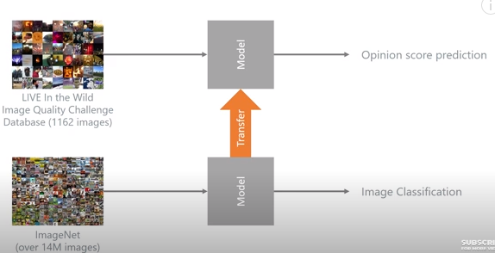
What do we do after this…

Slide 22
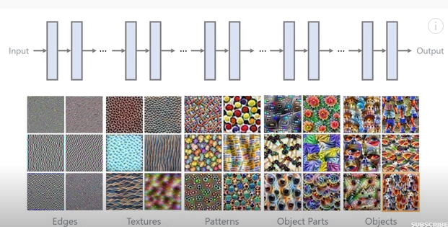
Generally what do each layer do in CNN …

Slide 23
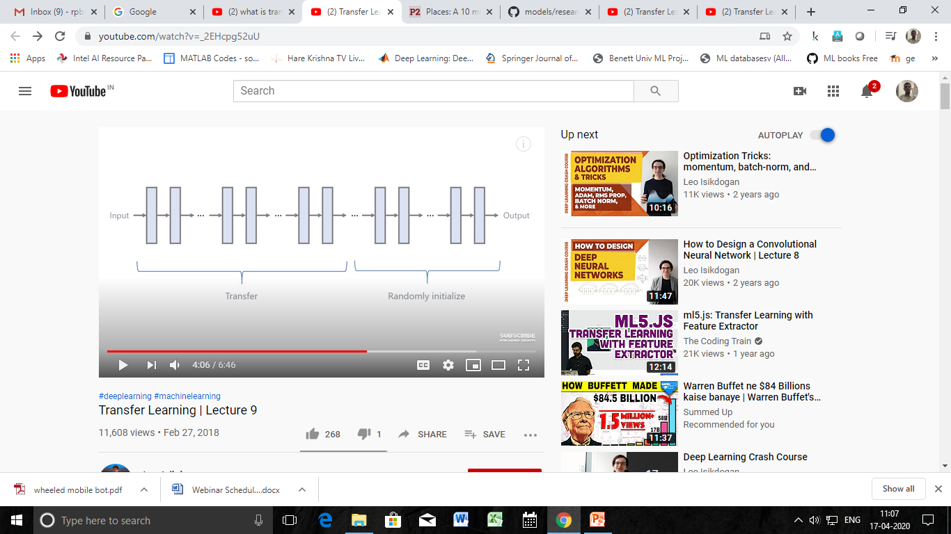
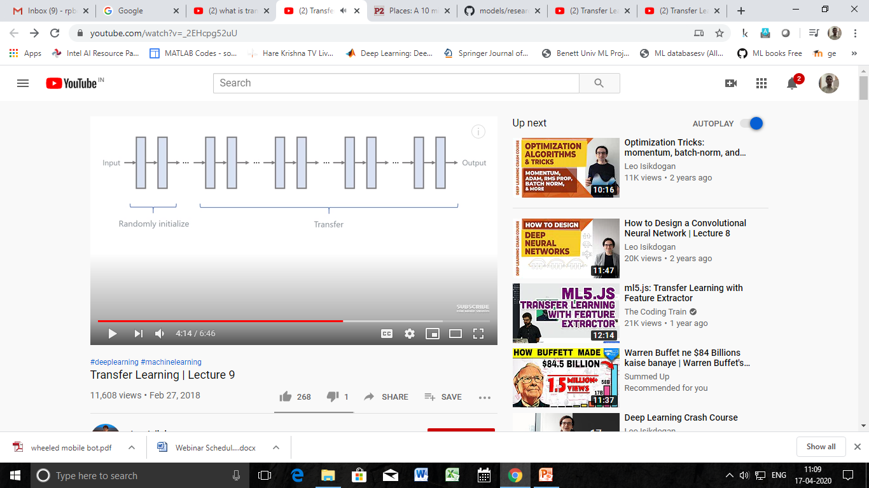
Can we do partial transfer learning ?

Slide 24
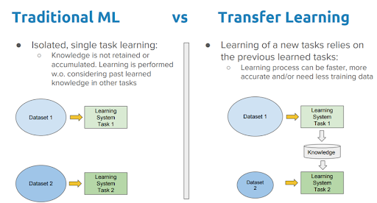
Where does transfer learning make sense ? (Transfer from A → Task B)
Task A and B has the same input x.
(Image : Image, Speech : Speech, Video :Video)
You have a lot more data for Task A than Task B.
Low level features from A could be helpful for learning B.

Slide 25
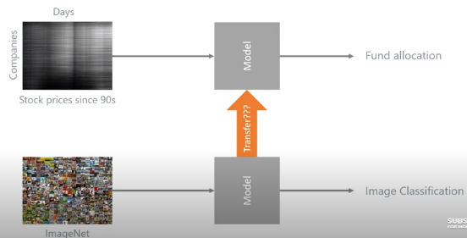
Where Transfer Learning may not work ?
Types of data and the task are different
Low size database to high size database will not work

Slide 26
Huge Databases
1. ImageNet
2. CIFAR 10, CIFAR-100
3. MNIST

Slide 27
ImageNet
ImageNet has over 14M images (14,197,122)
http://image-net.org/about-stats (more details)
27 High level categories (more than 20,000 subcategories)
(i.e. On average, there are over 500 images per subcategory)
Q: Does ImageNet own the images? Can I download the images? A: No, ImageNet does not own the copyright of the images. ImageNet only provides thumbnails and URLs of images, in a way similar to what image search engines do.
(http://image-net.org/download-imageurls)
Q.Who made this database ?
A: Stanford Vision Lab, Stanford University, Princeton University
(Prof. Li Fei-Fei, Princeton University, Stanford University)

Slide 28
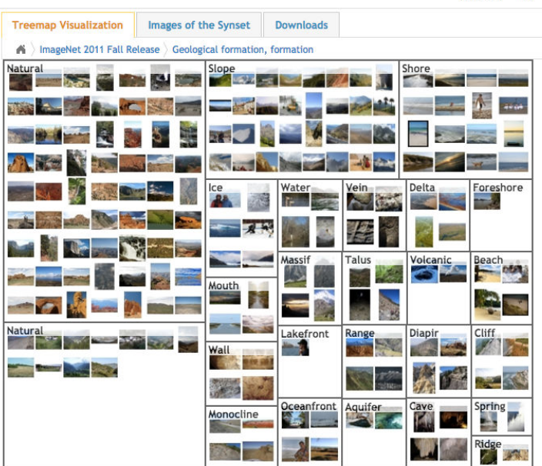
Few images of ImageNet

Slide 29
Cifar-10
CIFAR-10 dataset (Canadian Institute For Advanced Research)
Total of 10 classes and 60,000 images each of size 32x32.
The 10 different classes represent : airplanes, cars, birds, cats, deer, dogs, frogs, horses, ships, and trucks. There are 6,000 images of each class.
There are 50000 training images and 10000 test images

Slide 30
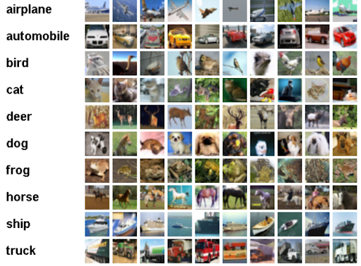
All 10 categories of images in the CIFAR-10 dataset.

Slide 31
The CIFAR-100 dataset
This dataset is just like the CIFAR-10, except it has 100 classes containing 600 images each.
There are 500 training images and 100 testing images per class.
The 100 classes in the CIFAR-100 are grouped into 20 superclasses.
Each image comes with a "fine" label (the class to which it belongs) and a "coarse" label (the superclass to which it belongs).
They were collected by Alex Krizhevsky, Vinod Nair, and Geoffrey Hinton

Slide 32
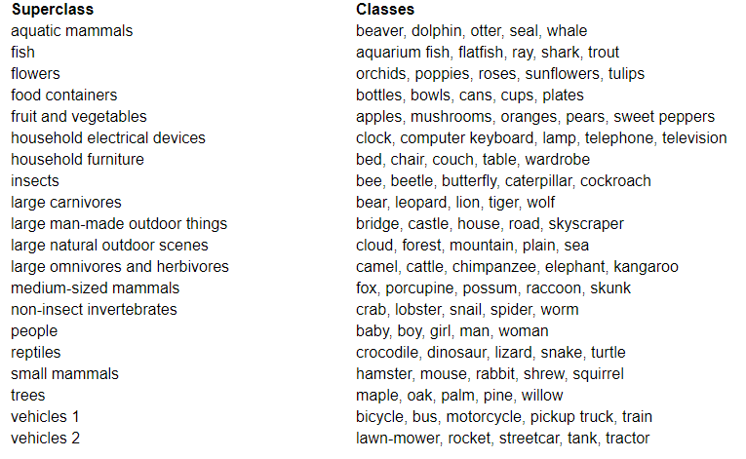
CIFAR-100

Slide 33
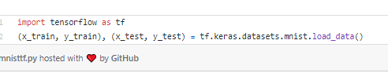
MNIST Dataset
The MNIST database of handwritten digits has a training set of 60,000 examples, and a test set of 10,000 examples. . Size: 28 x 28 pixel.
It is a subset of a larger set available from NIST. The digits have been size-normalized and centered in a fixed-size image.
Created by: Modified National Institute of Standards and Technology database.
An extended dataset similar to MNIST called EMNIST has been published in 2017, which contains 240,000 training images, and 40,000 testing images of handwritten digits and characters.

Slide 34
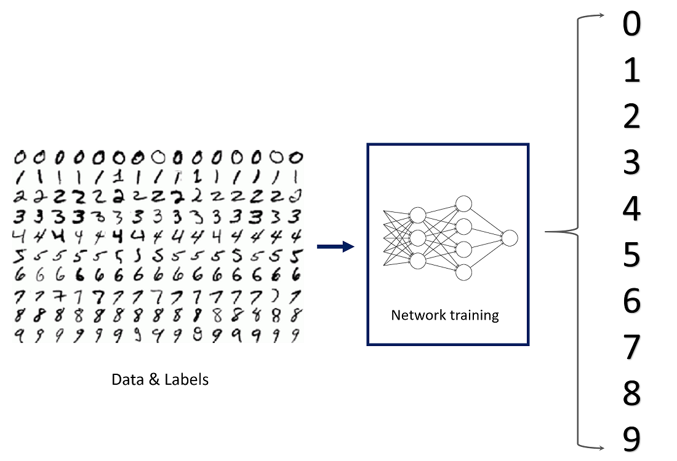
MNIST Database

Slide 35
Mobilenet V2 Model – trained at google 1.4 mill image , 1000 classes

Slide 41
Various other databases
https://en.wikipedia.org/wiki/List_of_datasets_for_machine-learning_research

Slide 42
Standard References
Ian Goodfellow, Yoshua Bengio and Aaron Courville, Deep Learning, MIT Press, 2016, ISBN: 9780262035613
Sinno Jialin Pan and Qiang Yang, A Survey on Transfer Learning, IEEE Transactions on Knowledge and Data Engineering, Vol 22. No 10, October 2010, pp1345-1359.
Pretained Models for - ILSVRC-2012-CLS image classification dataset. (All Pretrained Models – VGG, Resnet, Inception, MobileNet, NASNet, PNASNe) https://github.com/tensorflow/models/tree/master/research/slim#Pretrained
Youtube videos
https://www.youtube.com/watch?v=_2EHcpg52uU Leo Isikdogan, researcher at Intel Corporation)
https://www.youtube.com/watch?v=yofjFQddwHE (Andrew NG, Standford, Coursera Teacher)

